Slide 1



TUBES PBO

Slide 2



Rebah.an tech (RA-10)
LEADER:
Ahmad Fadillah
120140092
Anisa Prasetya
120140087
Rahman Pajri
120140118
William Rusli
120140090
Alfian Kafilah
120140109
M. Fikri Damar
120140077

Slide 3




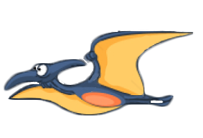

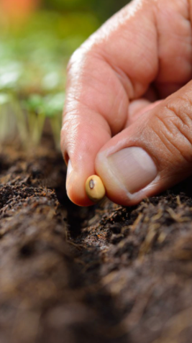





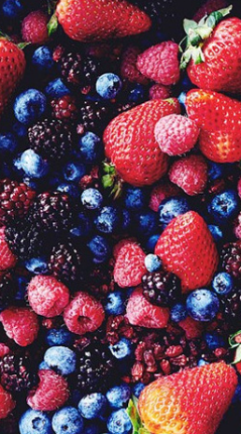
MORPHLING
rebah.an tech
Kelompok PBO10-RA
baru
fruits
seed
soya
tree
lama
rapper
bunga

Slide 4
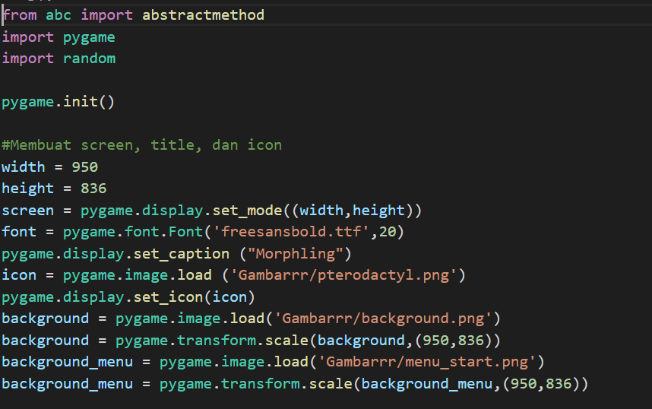
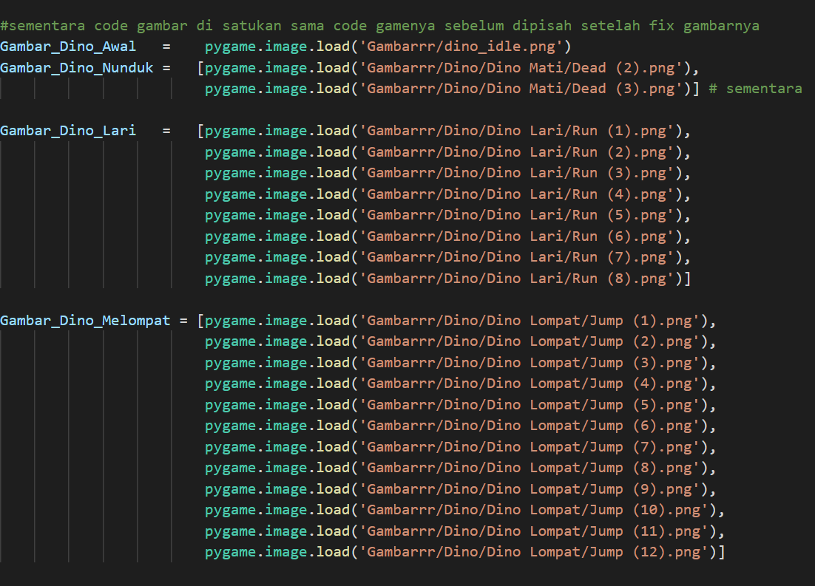

FOREST
07
design by hmpt
Kemajuan implementasi kelas (interaksi antar objek)
rebah.an tech
Kelompok PBO10-RA
about seed
A seed is an embryonic plant enclosed in a protective outer covering. The formation of the seed is part of the process of reproduction in seed plants, the spermatophytes, including the gymnosperm and angiosperm plants.
Seeds are the product of the ripened ovule, after fertilization by pollen and some growth within the mother plant. The embryo develops from the zygote, and the seed coat from the integuments of the ovule.
design by hmpt

Slide 5

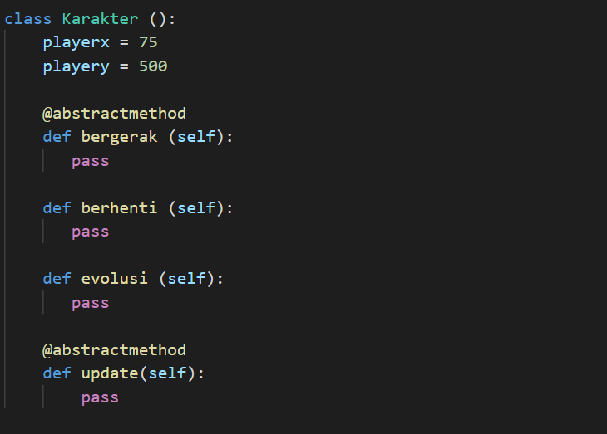
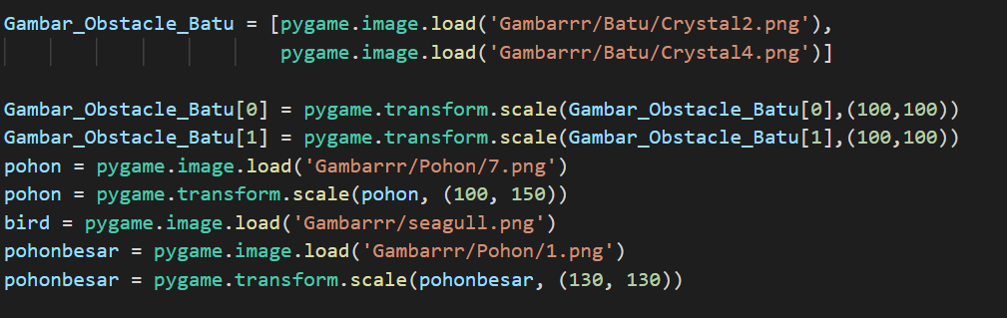
FOREST
07
design by hmpt
Kemajuan implementasi kelas (interaksi antar objek)
rebah.an tech
Kelompok PBO10-RA
about seed
A seed is an embryonic plant enclosed in a protective outer covering. The formation of the seed is part of the process of reproduction in seed plants, the spermatophytes, including the gymnosperm and angiosperm plants.
Seeds are the product of the ripened ovule, after fertilization by pollen and some growth within the mother plant. The embryo develops from the zygote, and the seed coat from the integuments of the ovule.
design by hmpt

Slide 6

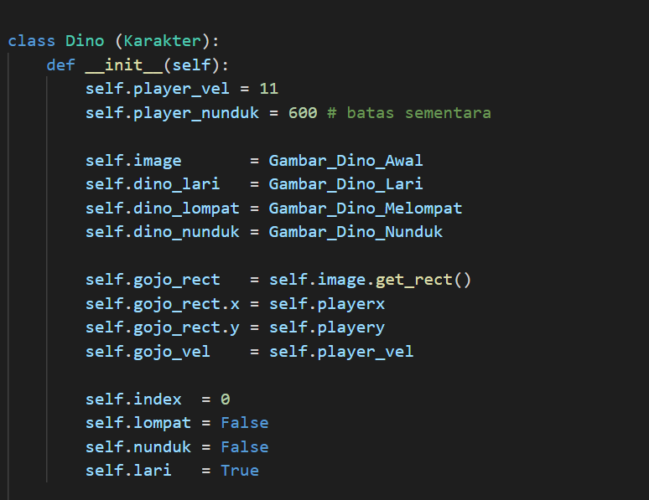
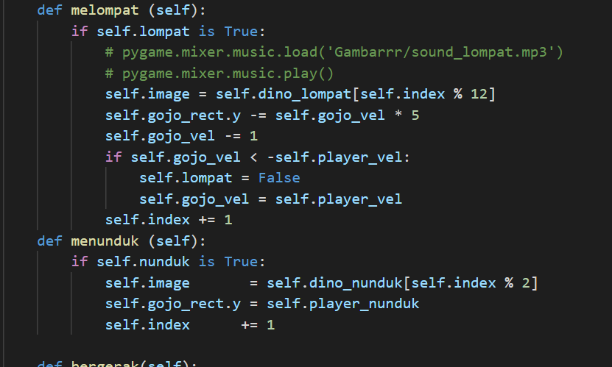
FOREST
07
design by hmpt
Kemajuan implementasi kelas (interaksi antar objek)
rebah.an tech
Kelompok PBO10-RA
about seed
A seed is an embryonic plant enclosed in a protective outer covering. The formation of the seed is part of the process of reproduction in seed plants, the spermatophytes, including the gymnosperm and angiosperm plants.
Seeds are the product of the ripened ovule, after fertilization by pollen and some growth within the mother plant. The embryo develops from the zygote, and the seed coat from the integuments of the ovule.
design by hmpt

Slide 7

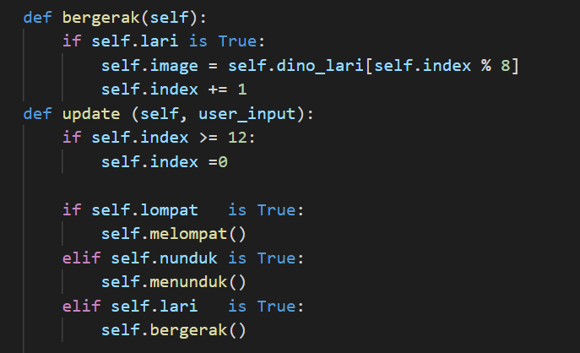
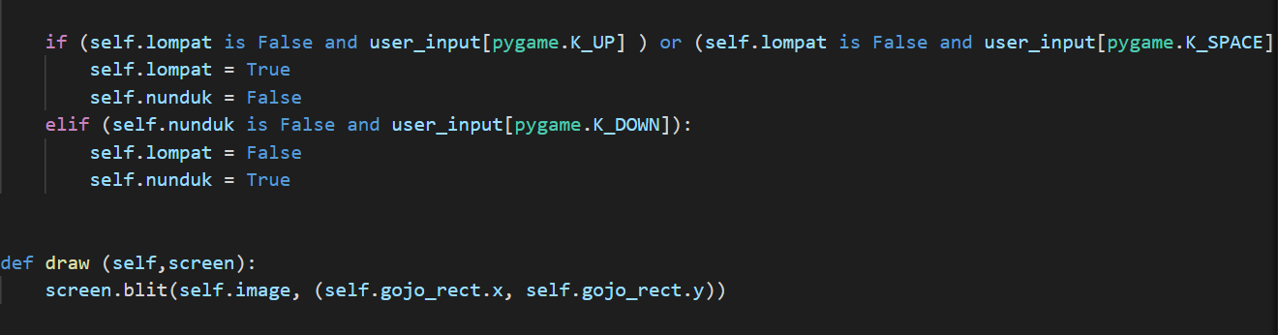
FOREST
07
design by hmpt
Kemajuan implementasi kelas (interaksi antar objek)
rebah.an tech
Kelompok PBO10-RA
about seed
A seed is an embryonic plant enclosed in a protective outer covering. The formation of the seed is part of the process of reproduction in seed plants, the spermatophytes, including the gymnosperm and angiosperm plants.
Seeds are the product of the ripened ovule, after fertilization by pollen and some growth within the mother plant. The embryo develops from the zygote, and the seed coat from the integuments of the ovule.
design by hmpt

Slide 8

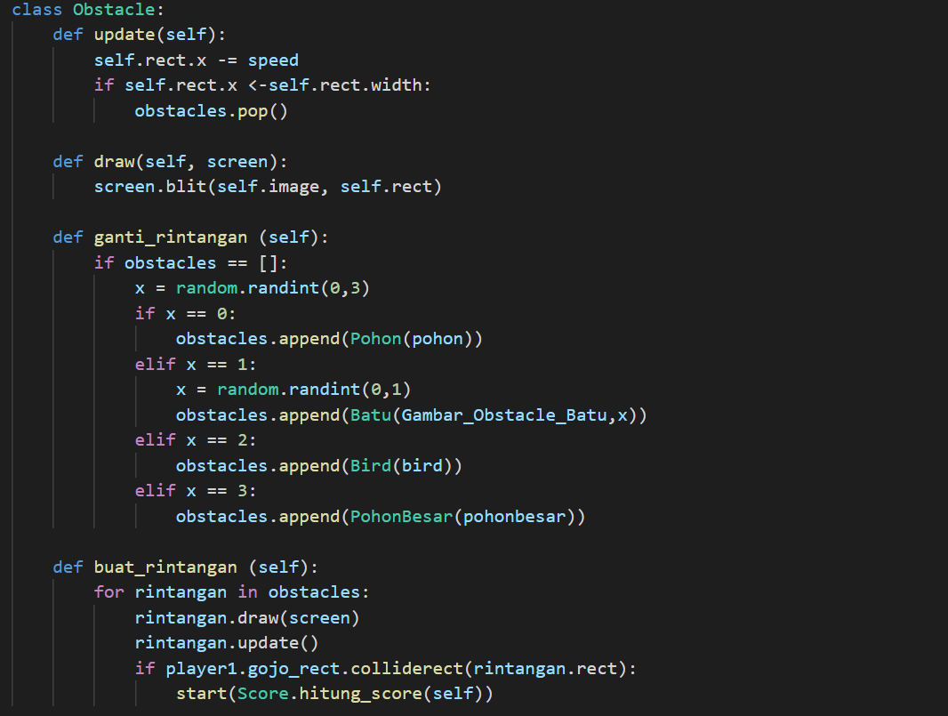
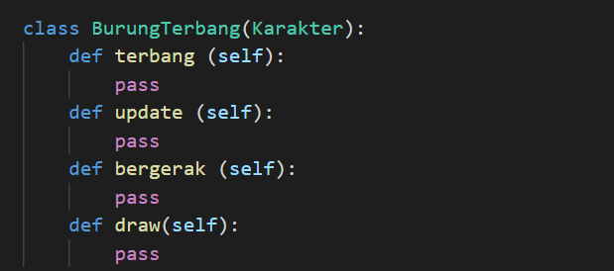
FOREST
07
design by hmpt
Kemajuan implementasi kelas (interaksi antar objek)
rebah.an tech
Kelompok PBO10-RA
about seed
A seed is an embryonic plant enclosed in a protective outer covering. The formation of the seed is part of the process of reproduction in seed plants, the spermatophytes, including the gymnosperm and angiosperm plants.
Seeds are the product of the ripened ovule, after fertilization by pollen and some growth within the mother plant. The embryo develops from the zygote, and the seed coat from the integuments of the ovule.
design by hmpt

Slide 9

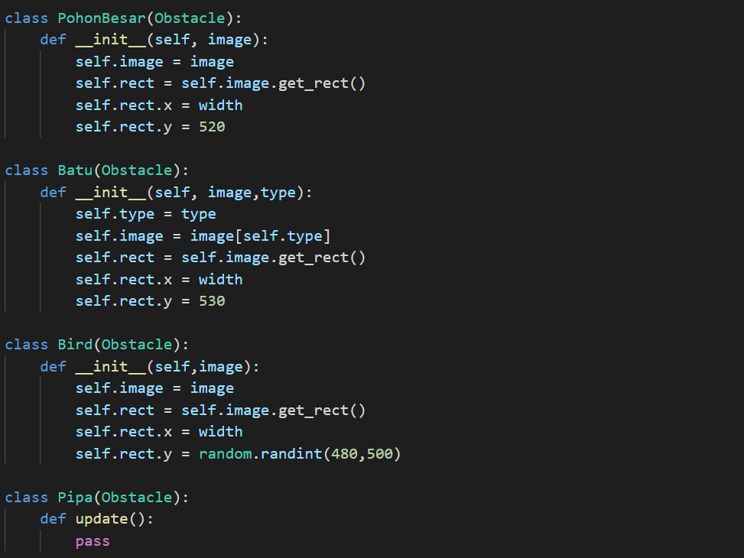
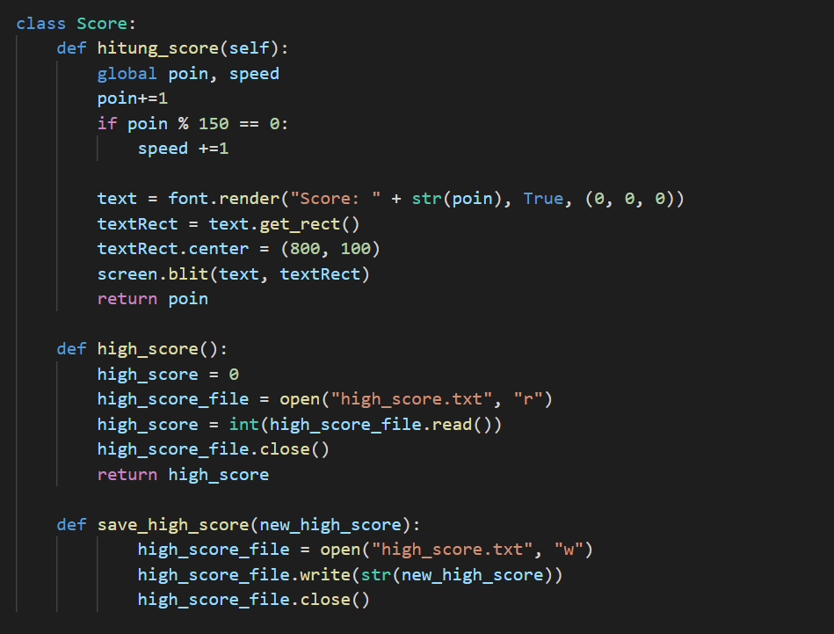
FOREST
07
design by hmpt
Kemajuan implementasi kelas (interaksi antar objek)
rebah.an tech
Kelompok PBO10-RA
about seed
A seed is an embryonic plant enclosed in a protective outer covering. The formation of the seed is part of the process of reproduction in seed plants, the spermatophytes, including the gymnosperm and angiosperm plants.
Seeds are the product of the ripened ovule, after fertilization by pollen and some growth within the mother plant. The embryo develops from the zygote, and the seed coat from the integuments of the ovule.
design by hmpt

Slide 10

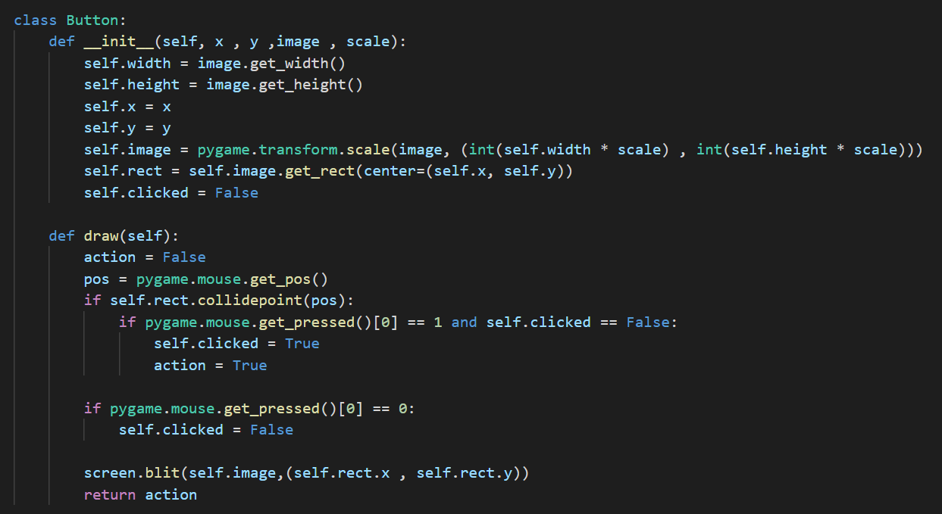
FOREST
07
design by hmpt
Kemajuan implementasi kelas (interaksi antar objek)
rebah.an tech
Kelompok PBO10-RA
about seed
A seed is an embryonic plant enclosed in a protective outer covering. The formation of the seed is part of the process of reproduction in seed plants, the spermatophytes, including the gymnosperm and angiosperm plants.
Seeds are the product of the ripened ovule, after fertilization by pollen and some growth within the mother plant. The embryo develops from the zygote, and the seed coat from the integuments of the ovule.
design by hmpt

Slide 11

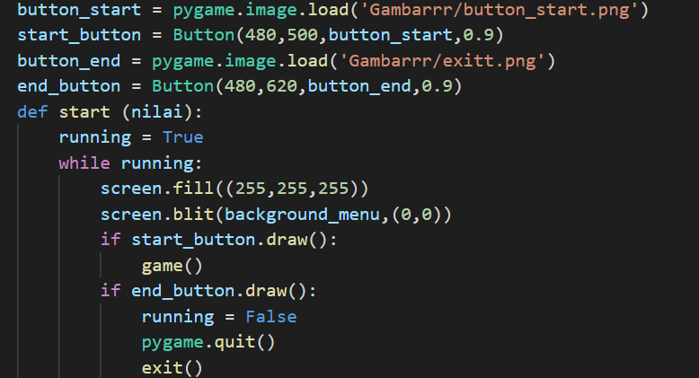
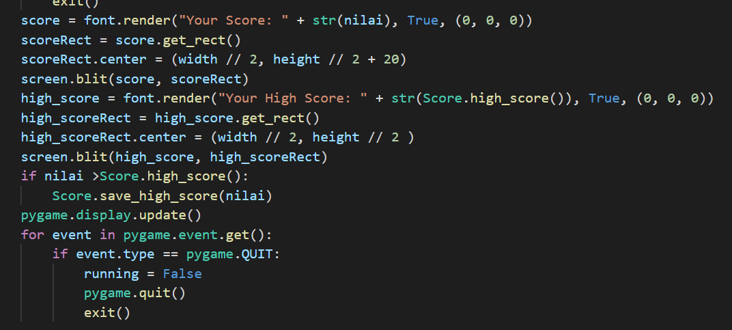
FOREST
07
design by hmpt
Kemajuan implementasi kelas (interaksi antar objek)
rebah.an tech
Kelompok PBO10-RA
about seed
A seed is an embryonic plant enclosed in a protective outer covering. The formation of the seed is part of the process of reproduction in seed plants, the spermatophytes, including the gymnosperm and angiosperm plants.
Seeds are the product of the ripened ovule, after fertilization by pollen and some growth within the mother plant. The embryo develops from the zygote, and the seed coat from the integuments of the ovule.
design by hmpt

Slide 12
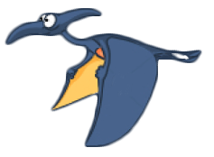
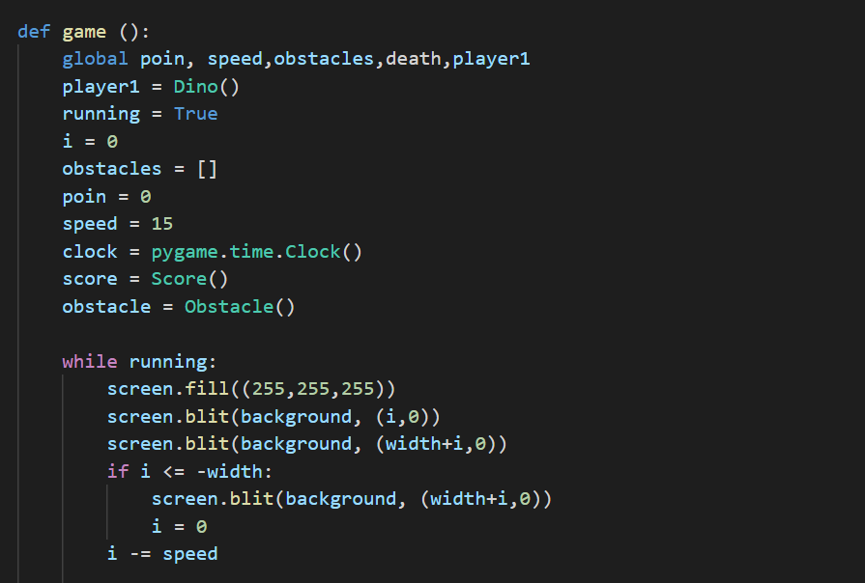
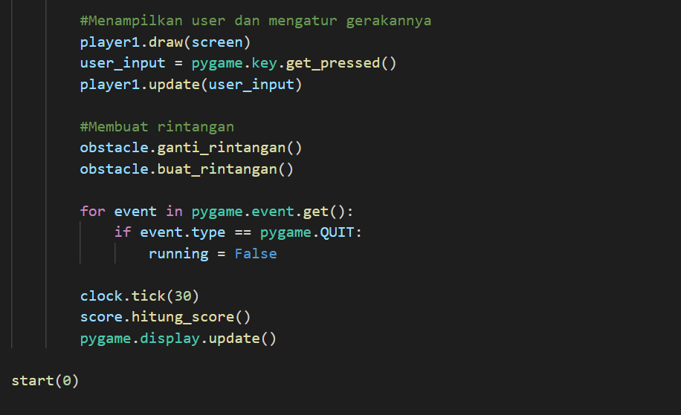
FOREST
07
design by hmpt
Kemajuan implementasi kelas (interaksi antar objek)
rebah.an tech
Kelompok PBO10-RA
about seed
A seed is an embryonic plant enclosed in a protective outer covering. The formation of the seed is part of the process of reproduction in seed plants, the spermatophytes, including the gymnosperm and angiosperm plants.
Seeds are the product of the ripened ovule, after fertilization by pollen and some growth within the mother plant. The embryo develops from the zygote, and the seed coat from the integuments of the ovule.
design by hmpt

Slide 13

FOREST
07
design by hmpt
Kemajuan implementasi kelas (interaksi antar objek)
rebah.an tech
https://github.com/AhmadFadillah12/Rebah.an-tech
Kelompok PBO10-RA
about seed
A seed is an embryonic plant enclosed in a protective outer covering. The formation of the seed is part of the process of reproduction in seed plants, the spermatophytes, including the gymnosperm and angiosperm plants.
Seeds are the product of the ripened ovule, after fertilization by pollen and some growth within the mother plant. The embryo develops from the zygote, and the seed coat from the integuments of the ovule.
design by hmpt

Slide 14

FOREST
07
design by hmpt
Kesimpulan
Dari kemajuan implementasi kelas (interaksi antar objek) berupa potongan source code yang telah dipresentasikan mengenai game MORPHLING, kelompok 10 telah menyelesaikan 70% dari keseluruhan program. Kami memahami serta menerapkan 4 pilar utama dalam Pemrograman Berioerintasi Objek yaitu inheritance, abstraksi, enkapsulasi dan polymorphisme. Kelompok kami berusaha menerapkan konsep tersebut dengan harapan akan membuat mahasiswa lain memahami 4 konsep utama Pemrograman Berorientasi Objek ketika memainkan game MORPHLING yang akan dibuat.
rebah.an tech
Kelompok PBO10-RA
about seed
A seed is an embryonic plant enclosed in a protective outer covering. The formation of the seed is part of the process of reproduction in seed plants, the spermatophytes, including the gymnosperm and angiosperm plants.
Seeds are the product of the ripened ovule, after fertilization by pollen and some growth within the mother plant. The embryo develops from the zygote, and the seed coat from the integuments of the ovule.
design by hmpt

Slide 15

morphling
rebah.an tech
Kelompok PBO 10-RA

Slide 16
Kasih
Terima
Morphling

